Slide 1
4. Spiral Model
The spiral model is intended for large, expensive
and complicated projects.
The spiral model focuses on identifying and eliminating high-risk problems by careful process design.
Boehm defines risk management as a discipline whose objectives are to-
identify, address, and eliminate software risk items before they become either threats to successful software operation or a major source of expensive software rework.

Slide 2
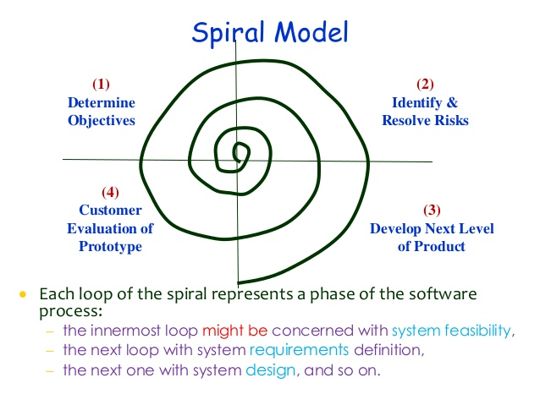
Spiral Model
& Plan for Next phase

Slide 3
Each phase in this model is split into four sectors (or quadrants)
The first quadrant identifies the objectives of the phase and the alternative solutions possible for the phase under consideration.
In the second quadrant we evaluate different alternatives based on the objectives and constraints. The evaluation is based on the risk perceptions for the project.

Slide 4
Each phase in this model is split into four sectors (or quadrants)
The third quadrant is the next step that emphasizes development of strategies that resolve the uncertainties and risks. This may involve activities, such as benchmarking, simulation, and prototyping.
In the last or fourth quadrant we determine the objective that should be fulfilled in the next cycle of our software development in order to build the complete system.

Slide 5
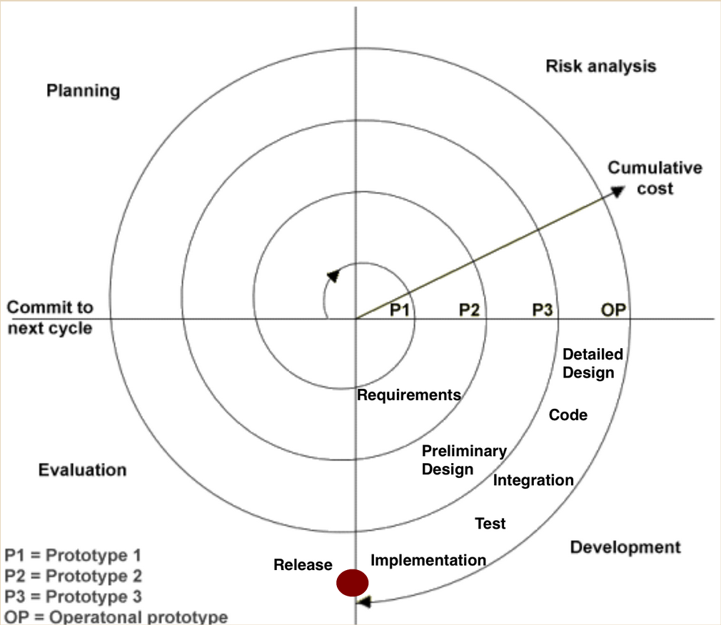

Slide 6
Planning Phase: Requirements are gathered during the planning phase. Requirements like ‘BRS’ that is ‘Bussiness Requirement Specifications’ and ‘SRS’ that is ‘System Requirement specifications’.
Risk Analysis: In the risk analysis phase, a process is undertaken to identify risk and alternate solutions. A prototype is produced at the end of the risk analysis phase. If any risk is found during the risk analysis then alternate solutions are suggested and implemented.
Development Phase: In this phase software is developed, along with testing at the end of the phase. Hence in this phase the development and testing is done.
Evaluation phase: This phase allows the customer to evaluate the output of the project to date before the project continues to the next spiral.

Slide 7
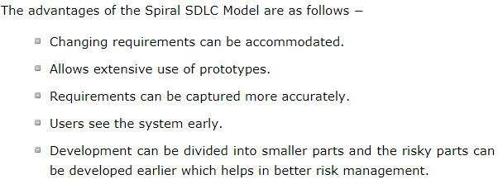
Advantages

Slide 8
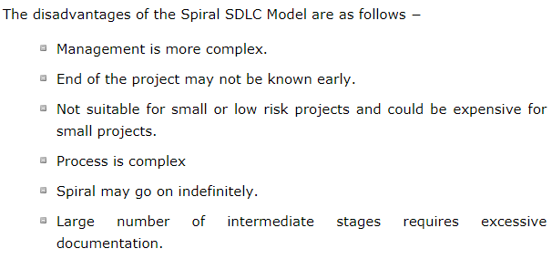
Disadvantages

Slide 9
When to Use Spiral Model….
When costs and risk evaluation is important
For medium to high-risk projects
Long-term project commitment unwise because of potential changes to economic priorities
Users are unsure of their needs
Requirements are complex
New product line
Significant changes are expected (research and exploration)

